Slide 1
lrd: An R Package and Shiny Application for Quickly Scoring Lexical Data in R
Nicholas p. maxwell¹, Mark J. HUFF¹, Erin M. Buchanan²

Slide 2
Introduction
Recall testing is commonly used to gauge memory retrieval
Cued-recall testing
Free-recall testing

Slide 3
Introduction
Recall testing has been used extensively throughout psychological research
Approximately 18,000 publications since 2000
Across multiple subfields of psychology

Slide 4
Introduction
This can be partly attributed to the rise of the internet and more powerful computers
Online recruitment platforms like Prolific or Mturk
Large-scale normed databases for stimuli creation (English Lexicon Project; Balota et al., 2007; Small World of Words; De Deyne et al., 2019)
Tools for automatically generating stimuli (lexOPS; Taylor, Beith & Sereno, 2019)
Notes:
However, little attention has been paid to creating tools for processing the large amounts of data that are generated from these studies

Slide 5
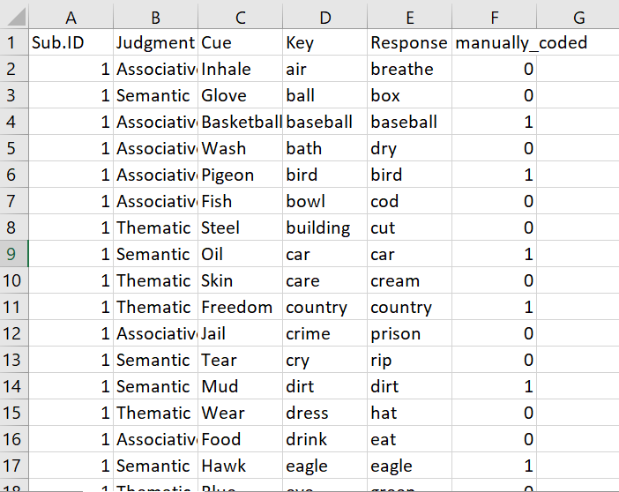
Cued-Recall Example
Cued-recall data is scored by matching participant response to a key.
Time intensive and error prone!
Notes:
Time intensive and error prone! This was taken from an actual dataset I hand coded – 13,924 rows!

Slide 6
Introduction
An alternative is to automate the coding process
Must be able to account for spelling errors!
This requires a sufficient degree of flexibility to be programmed into the scoring package
Notes:
Simple text matching won’t work! Misspellings, embedded code leftover from survey software, etc.

Slide 7
The lrd Package
lrd (Lexical Response Data) is an R package designed to automate scoring of recall data while controlling for participant errors.
Cued-recall
Free recall
Sentence responses
Open source and freely available via gitihub
Notes:
To address this, I created lrd, which is an R package designed to scored data. It also contains several functions for plotting data and interpreting scored output

Slide 8
The lrd Package
lrd is also available as an R Shiny application!
Shiny provides and interactive GUI for using lrd. No programming required!
https://github.com/npm27/lrd/

Slide 9
lrd vs Hand Coded Data
Used lrd to score sets of cued and free-recall data

Slide 10
Method

Slide 11
Results

Slide 12
Summary
lrd allows researchers to quickly score several types of recall data
The goal is to provide a standardized, open-source method for processing lexical output across psychological studies.

Slide 13
Questions?

